Slide 1
Compiler Design
Lexical Analysis

Slide 2
Outline
Role of lexical analyzer
Specification of tokens
Recognition of tokens
Lexical analyzer generator
Finite automata
Design of lexical analyzer generator

Slide 3
The role of lexical analyzer
token
Source
program
Lexical Analyzer
Parser
To semantic
analysis
getNextToken
Symbol
table

Slide 4
Why to separate Lexical analysis and parsing?
Simplicity of design- if a new language is to be designed, separating the lexical and syntax phase will help to design an effective compiler.
Improving compiler efficiency- A large amount of time is spent in reading the source program and converting it into tokens. Specialized buffering techniques can be used to speed up the reading of input characters and read the tokens.
Enhancing compiler portability- Input alphabet peculiarities and other device specific anomalies can be restricted to lexical analyzer.

Slide 5
Tokens, Patterns and Lexemes
A token is a pair a token name and an optional token value. It is a set of strings which have some collective meaning. Ex:- Identifiers, Keywords, Operators etc.
A pattern is a description of the form that the lexemes of a token may take. It is also defined as a set of rules defining a token. Ex:- Id- letter followed by a digit.
A lexeme is a sequence of characters in the source program that matches the pattern for a token.
Ex:- int abc; (Here abc is a string which matched by the pattern of an identifier, therefore abc is a lexeme. For a token class, there may be many lexemes.

Slide 6
Example
Token
Informal description
Sample lexemes
if
Characters i, f
if
else
Characters e, l, s, e
else
comparison
< or > or <= or >= or == or !=
<=, !=
id
Letter followed by letter and digits
pi, score, D2
number
Any numeric constant
3.14159, 0, 6.02e23
literal
Anything but sorrounded by “ “
except “
“smit”

Slide 7
Implementation of Lexical Analyzer
Goal is to partition the string.
Read the string left to right, recognizing one token at a time.
“Lookahead” may be required to decide where one token ends and the next token begins.
Recognize substrings(lexeme) corresponding to tokens.
Identify the token class of each lexeme.

Slide 8
Lexical Analysis
Attributes of a token
- Information about the token.
-Used to differentiate various lexemes of a token
- used during Semantic analysis
Types of a token
-Identifier
-Keyword
-Single Char Operators : +,-,* etc
-Multiple char Operators : >=, ==, ++ etc
-Numbers
-Char constants : ‘a’, ‘b’,…………..
-String constants : “abc”,……………….

Slide 9
Types of Non-Tokens
Comments
White Spaces , \n, \t etc

Slide 10
Attributes for tokens
E = M * C ** 2
<id, pointer to symbol table entry for E>
<assign-op>
<id, pointer to symbol table entry for M>
<mult-op>
<id, pointer to symbol table entry for C>
<exp-op>
<number, integer value 2>

Slide 11
Lexical errors
Some errors are out of power of lexical analyzer to recognize:
fi (a == f(x)) … Lexical analyzer will not be able to tell whether fi is a misspelled keyword or undefined function identifier.
However it may be able to recognize errors like:
d = 2r
Such errors are recognized when no pattern for tokens matches a character sequence

Slide 12
Error recovery
Panic mode: successive characters are ignored until we reach to a well formed token.
Ex: @@fi ---→ fi
Adequate in an inactive computing environment.
Delete one character from the remaining input
Ex: ab123cd---→abcd
Insert a missing character into the remaining input.
Ex: whle(a>b) --→ while(a>b)

Slide 13
Error recovery
Replace an erroneous character by another character.
Ex: whilf(a>b)---→ while(a>b)
Transpose two adjacent characters
Ex: fi(a>b) --→if(a>b)
The idea of these error correction techniques is to check whether a prefix of the remaining input can be transformed into a valid lexeme by just applying a single error transformation mechanism.

Slide 14
Input buffering
Sometimes lexical analyzer needs to look ahead some symbols to decide about the token to return.
Ex: In C language, we need to look after -, = or < to decide what token to return.
We need to introduce a two buffer scheme to handle large look-aheads safely.

Slide 15
Input Buffering in Lexical Analyzer
E = M*C**2
Forward Pointer
N Char N Char
Here, N = 1024 or 4096 characters
Lexeme Beginning Pointer
We read N input characters into each half of the buffer with one system
read command, rather than invoking a read command for each input character. If fewer than N characters remain in the input, then a special character ‘eof’ is read into the buffer after the input characters, ie. ‘eof’ marks the end of source file and is different from any input character.
E = M* | C**2 eof

Slide 16
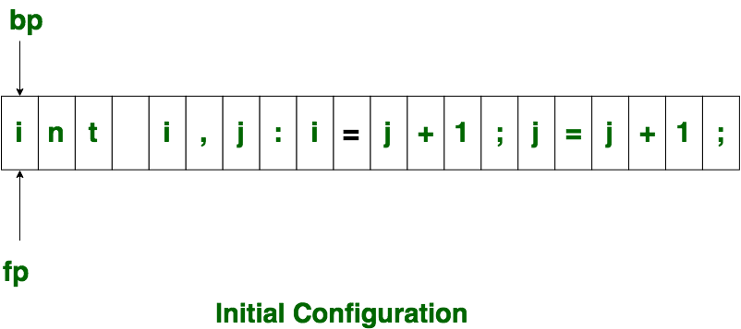
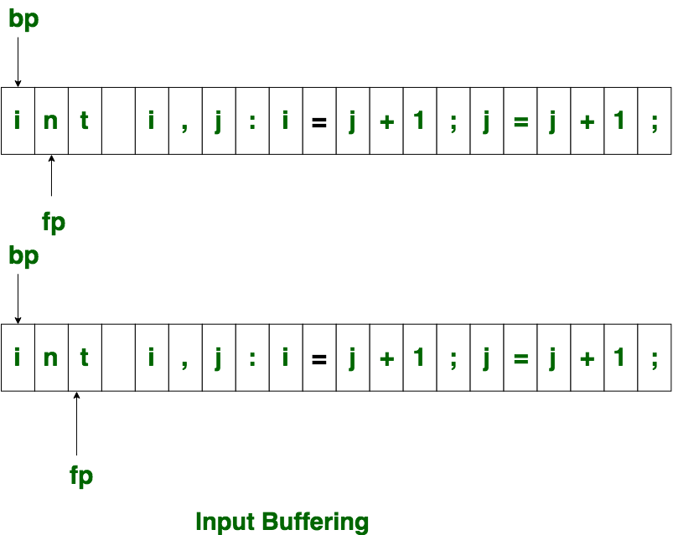
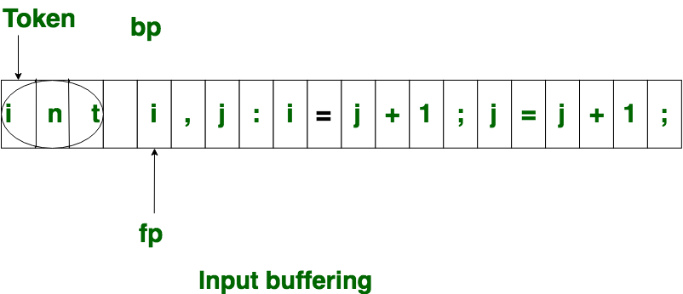

Slide 17
Lexical Analysis (Contd.)
Working Principle
if fp points to the end of 1st half of a buffer
Begin
Reload the Second half
fp = fp+1;
End
else if fp points to the end of 2nd half of a buffer
Begin
Reload the first half;
move fp to the beginning of the first half;
End
else fp = fp+1;

Slide 18
Two pointers to the input buffer are maintained. The string of characters between the two pointers is the current lexeme. Initially, both pointers point to the first character of the next lexeme to be found. One, called the forward pointer, scans ahead until a match for a pattern is found. Once the next lexeme
is determined, the forward pointer is set to the character at its right end.
After the lexeme is processed, both pointers are set to the character immediately past the lexeme. With this scheme, comments and white space can be treated as patterns that yield no token.

Slide 19
If the forward pointer is about to move past the halfway mark, the right half is filled with ‘N’ new input characters. If the forward pointer is about to move past the right end of the buffer, the left half is filled with N new characters and the forward pointer wraps around to the beginning of the buffer.
This buffering scheme works quite well most of the time, but with it the amount of look-ahead is limited, and this limited look-ahead may make it impossible lo recognize tokens in situations where the distance that the forward pointer must travel is more than the length of the buffer.
^{Ex:} DECLARE (ARGl, ARG2, . . . , ARGn) in a program;
• It cannot determine whether the DECLARE is a keyword or an array name until the character that follows the right parenthesis.

Slide 22
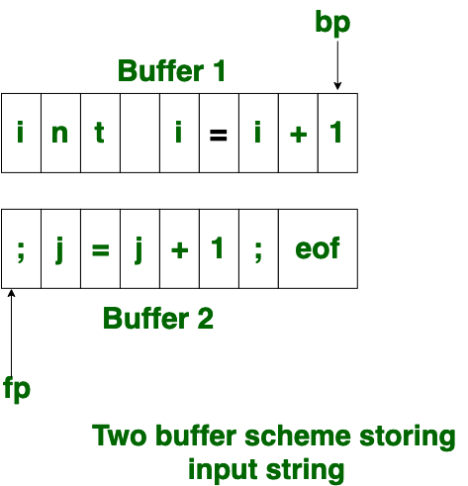

Slide 23
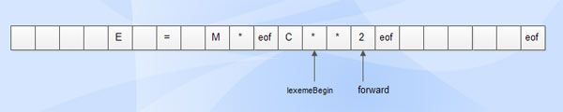
Sentinel in Lexical Analysis
The sentinel is a special character that cannot be part of the source program. (eof character is used as sentinel).
Except at the ends of the buffer halves, the code requires two tests for each advancement of the forward pointer. It can be reduced to one by the incorporation of a sentinel element at the end. Since ‘N’ input characters are encountered between ‘eof’ , the average number of tests per input character is very close to 1.

Slide 24
Sentinels
E = M eof * C * * 2 eof
eof
fp = fp+1;
if fp = eof then
Begin
if fp at the end of the first half then Begin
Reload second half;
fp = fp+1;
End
else if fp is at the end of the 2nd half then Begin
Reload first half;
Move fp to the beginning of the First half;
End
else
Terminate Lexical Analysis
End

Slide 25
Specification of tokens
In theory of compilation regular expressions are used to formalize the specification of tokens
Regular expressions are means for specifying regular languages
Example:
Letter_(letter_ | digit)*
Each regular expression is a pattern specifying the form of strings

Slide 26
Regular expressions
Ɛ is a regular expression, L(Ɛ) = {Ɛ}
If a is a symbol in ∑then a is a regular expression, L(a) = {a}
(r) | (s) is a regular expression denoting the language L(r) ∪ L(s)
(r)(s) is a regular expression denoting the language L(r)L(s)
(r)* is a regular expression denoting (L9r))*
(r) is a regular expression denting L(r)

Slide 27
Regular definitions
d1 -> r1
d2 -> r2
…
dn -> rn
Example:
letter_ -> A | B | … | Z | a | b | … | Z | _
digit -> 0 | 1 | … | 9
id -> letter_ (letter_ | digit)*

Slide 28
Extensions
One or more instances: (r)⁺
Zero of one instances: r?
Character classes: [abc]
Example:
letter_ -> [A-Za-z_]
digit -> [0-9]
id -> letter_(letter|digit)*

Slide 29
Recognition of tokens
Starting point is the language grammar to understand the tokens:
stmt -> if expr then stmt
| if expr then stmt else stmt
| Ɛ
expr -> term relop term
| term
term -> id
| number

Slide 30
Recognition of tokens (cont.)
The next step is to formalize the patterns:
digit -> [0-9]
Digits -> digit+
number -> digit(.digits)? (E[+-]? Digit)?
letter -> [A-Za-z_]
id -> letter (letter|digit)*
If -> if
Then -> then
Else -> else
Relop -> < | > | <= | >= | = | <>
We also need to handle whitespaces:
ws -> (blank | tab | newline)⁺

Slide 31
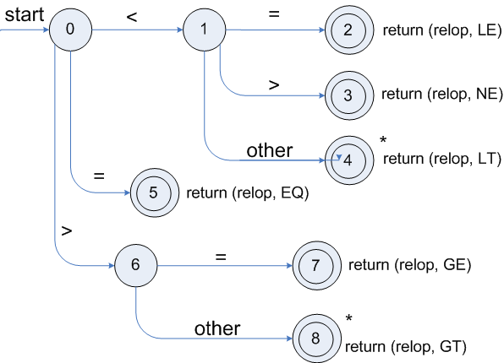
Transition diagrams
Transition diagram for relop

Slide 32
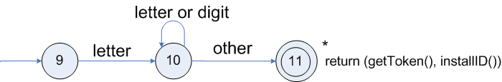
Transition diagrams (cont.)
Transition diagram for reserved words and identifiers

Slide 33
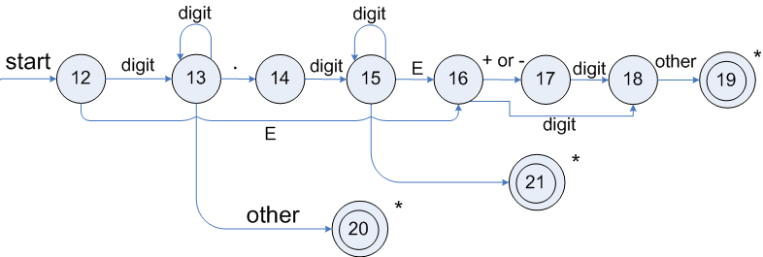
Transition diagrams (cont.)
Transition diagram for unsigned numbers

Slide 34
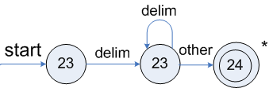
Transition diagrams (cont.)
Transition diagram for whitespace

Slide 35
Architecture of a transition-diagram-based lexical analyzer
TOKEN getRelop()
{
TOKEN retToken = new (RELOP)
while (1) { /* repeat character processing until a
return or failure occurs */
switch(state) {
case 0: c= nextchar();
if (c == ‘<‘) state = 1;
else if (c == ‘=‘) state = 5;
else if (c == ‘>’) state = 6;
else fail(); /* lexeme is not a relop */
break;
case 1: …
…
case 8: retract();
retToken.attribute = GT;
return(retToken);
}

Slide 36
Lexical Analyzer Generator - Lex
Lex Source program
lex.l
Lexical Compiler
lex.yy.c
C
compiler
lex.yy.c
a.out
a.out
Sequence of tokens
Input stream

Slide 37
Structure of Lex programs
declarations
%%
translation rules
%%
auxiliary functions
Pattern {Action}

Slide 38
Example
%{
/* definitions of manifest constants
LT, LE, EQ, NE, GT, GE,
IF, THEN, ELSE, ID, NUMBER, RELOP */
%}
/* regular definitions
delim [ \t\n]
ws {delim}+
letter [A-Za-z]
digit [0-9]
id {letter}({letter}|{digit})*
number {digit}+(\.{digit}+)?(E[+-]?{digit}+)?
%%
{ws} {/* no action and no return */}
if {return(IF);}
then {return(THEN);}
else {return(ELSE);}
{id} {yylval = (int) installID(); return(ID); }
{number} {yylval = (int) installNum(); return(NUMBER);}
…
Int installID() {/* funtion to install the lexeme, whose first character is pointed to by yytext, and whose length is yyleng, into the symbol table and return a pointer thereto */
}
Int installNum() { /* similar to installID, but puts numerical constants into a separate table */
}

Slide 39
Finite Automata
Regular expressions = specification
Finite automata = implementation
A finite automaton consists of
An input alphabet Σ
A set of states S
A start state n
A set of accepting states F ⊆ S
A set of transitions state →^{input} state

Slide 40
Finite Automata
Transition
s₁ →ª s₂
Is read
In state s₁ on input “a” go to state s₂
If end of input
If in accepting state => accept, othewise => reject
If no transition possible => reject

Slide 41
Finite Automata State Graphs
A state
The start state
An accepting state
a
A transition

Slide 42
A Simple Example
A finite automaton that accepts only “1”
A finite automaton accepts a string if we can follow transitions labeled with the characters in the string from the start to some accepting state
1

Slide 43
Another Simple Example
A finite automaton accepting any number of 1’s followed by a single 0
Alphabet: {0,1}
Check that “1110” is accepted but “110…” is not
1
0

Slide 44
And Another Example
Alphabet {0,1}
What language does this recognize?
1
0
0
0
1
1

Slide 45
And Another Example
Alphabet still { 0, 1 }
The operation of the automaton is not completely defined by the input
On input “11” the automaton could be in either state
1
1

Slide 46
Epsilon Moves
Another kind of transition: ε-moves
ε
A
B
Machine can move from state A to state B without reading input

Slide 47
Deterministic and Nondeterministic Automata
Deterministic Finite Automata (DFA)
One transition per input per state
No ε-moves
Nondeterministic Finite Automata (NFA)
Can have multiple transitions for one input in a given state
Can have ε-moves
Finite automata have finite memory
Need only to encode the current state

Slide 48
Execution of Finite Automata
A DFA can take only one path through the state graph
Completely determined by input
NFAs can choose
Whether to make ε-moves
Which of multiple transitions for a single input to take

Slide 49
Acceptance of NFAs
An NFA can get into multiple states
1
0
1
0
Input:
1
0
1
Rule: NFA accepts if it can get in a final state

Slide 50
NFA vs. DFA (1)
NFAs and DFAs recognize the same set of languages (regular languages)
DFAs are easier to implement
There are no choices to consider

Slide 51
NFA vs. DFA (2)
For a given language the NFA can be simpler than the DFA
1
0
0
NFA
0
1
0
0
0
DFA
1
1
DFA can be exponentially larger than NFA

Slide 52
Regular Expressions to Finite Automata
High-level sketch
NFA
Regular
expressions
DFA
Lexical
Specification
Table-driven
Implementation of DFA

Slide 53
Regular Expressions to NFA (1)
For each kind of rexp, define an NFA
Notation: NFA for rexp A
A
For ε
ε
For input a
a

Slide 54
Regular Expressions to NFA (2)
For AB
ε
A
B
For A | B
B
ε
ε
ε
ε
A

Slide 55
Regular Expressions to NFA (3)
For A*
ε
A
ε
ε

Slide 56
Example of RegExp -> NFA conversion
Consider the regular expression
(1 | 0)*1
The NFA is
ε
1
ε
ε
C
E
A
B
1
ε
0
G
H
ε
I
J
ε
D
F
ε
ε

Slide 57
Next
NFA
Regular
expressions
DFA
Lexical
Specification
Table-driven
Implementation of DFA

Slide 58
NFA to DFA. The Trick
Simulate the NFA
Each state of resulting DFA
= a non-empty subset of states of the NFA
Start state
= the set of NFA states reachable through ε-moves from NFA start state
Add a transition S →ª S’ to DFA iff
S’ is the set of NFA states reachable from the states in S after seeing the input a
considering ε-moves as well

Slide 59
NFA -> DFA Example
ε
1
ε
ε
C
E
A
B
1
ε
0
G
H
ε
I
J
ε
D
F
ε
ε
0
0
FGABCDHI
0
1
ABCDHI
1
1
EJGABCDHI

Slide 60
NFA to DFA. Remark
An NFA may be in many states at any time
How many different states ?
If there are N states, the NFA must be in some subset of those N states
How many non-empty subsets are there?
2^{N} - 1 = finitely many, but exponentially many

Slide 61
Implementation
A DFA can be implemented by a 2D table T
One dimension is “states”
Other dimension is “input symbols”
For every transition S_{i} →ª S_{k} define T[i,a] = k
DFA “execution”
If in state S_{i} and input a, read T[i,a] = k and skip to state S_{k}
Very efficient

Slide 62
Table Implementation of a DFA
0
0
T
0
1
S
1
1
U
 | 0 | 1
S | T | U
T | T | U
U | T | U

Slide 63
Implementation (Cont.)
NFA -> DFA conversion is at the heart of tools such as flex or jflex
But, DFAs can be huge
In practice, flex-like tools trade off speed for space in the choice of NFA and DFA representations

Slide 64
Readings
Chapter 3 of the book

